Slide 1


Advanced JavaScript

Slide 2
Objectives
Arrow Function
Basic Data Structures (Queue - Stack - Tree)
Asynchronous programming
Event Queue

Slide 3
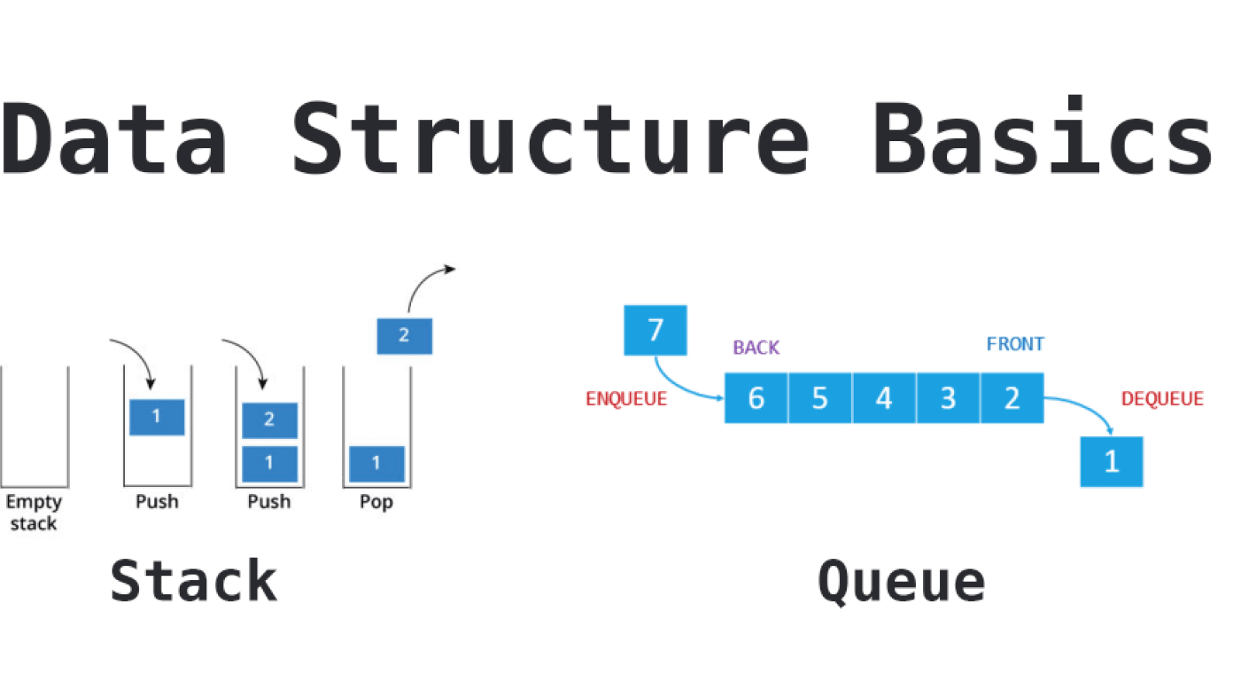
Some Basic Computer Science Data Structures
1- Queue
data enters the queue at the back and leaves from the front; a first in, first out (FIFO) data structure.
Queue terminology:
Enqueue - an operation that adds an item to the back of a queue.
Dequeue - an operation that removes an item from the front of a queue.
Source: https://tutsmaster.org/how-to-represent-stack-in-c-data-structure/

Slide 4
Some Basic Computer Science Data Structures
2- Stack
items are added to the top of the stack and removed from the top of the stack;
a last in, first out (LIFO) data structure.
Stack terminology:
Push - an operation that adds an item to the top of a stack.
Pop - an operation that removes an item from the top of a stack.
Source: https://tutsmaster.org/how-to-represent-stack-in-c-data-structure/

Slide 5
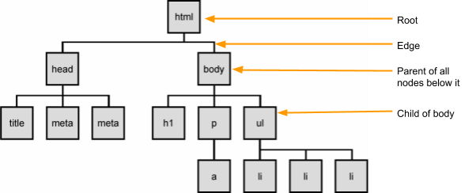
Some Basic Computer Science Data Structures
3- Tree
stores data in a hierarchy made up of a collection of nodes connected by edges.
Image modified from https://programmingfordigitalart.wordpress.com/2015/03/05/w6-html-and-js/

Slide 6
Arrow Function
An alternative way to write a traditional function in JavaScript is to use the arrow function expression
function(a, b){ return a + b } (a,b) => return a + b
function sum(a, b){ return a + b } let sum = (a,b) => a + b

Slide 7
Asynchronous Programming
Synchronous code: when lines of code are executed in order
Asynchronous code: The order to execute each line of code is given as it is encountered BUT your program doesn’t stop and wait for an instruction to be completely executed before moving on to the next instruction.
Everything can move quicker because other tasks can execute in the background, but we need to make sure they are executed in the correct order.

Slide 8
Asynchronous Programming
function a(s, callback) { callback(s); } function b(s) { console.log(s + "! It's me!"); } //call function 'a' with a predefined callback 'b' a("Hello world", b); //call function 'a' with a custom callback. a("Hello world", function(s) { console.log(s + ", I can use callbacks"); });
Callback functions: a function that is passed as an argument to another function. The callback isn’t executed right away. It is executed later, somewhere within the calling function.

Slide 9
Asynchronous Programming
A useful method that requires a callback function to work is the map() function, which creates a new array with the results of calling a provided function on every element in this array:
// create an array let numbers = [1, 4, 9, 16]; // call map(), passing a function let mapped = numbers.map(function(x) { return x * 2 }); // log the result console.log(mapped); // Output would be: 2,8,18,32

Slide 10
Asynchronous Programming
Timing events: with JavaScript you can make certain functions of code wait for a certain amount of time before being executed.
setTimeout: setTimeout(aFunction, 3000);
setInterval: setInterval(aFunction, 3000);

Slide 11
Asynchronous Programming
Promises: allows the interpreter to carry on with other tasks while a function is executed without waiting for that function to finish.
doSomethingThatReturnsAPromise().then(successCallback, failureCallback);
require('isomorphic-fetch'); fetch("https://www.example_API.com/") .then(res => res.json()) .then((result) => { console.log(result); }), (error) => { console.log(error); }

Slide 12
Asynchronous Programming
You could also create your own promise object:
let promise = new Promise(function(resolve, reject) { // do something, possibly async, then… if (/* everything turned out fine */) { resolve("Stuff worked!"); } else { reject(Error("It broke")); } }); //Code example src: //https://developers.google.com/web/fundamentals/primers/promises

Slide 13
Asynchronous Programming
Async functions: can contain an await expression that pauses the execution of the async function and waits for the passed Promise's resolution, and then resumes the async function's execution and returns the resolved value
require('isomorphic-fetch'); const request = async () => { const response = await fetch("https://www.example_API.com/"); const json = await response.json(); console.log(json); } request();

Slide 14
How Does JavaScript Work?
JavaScript is a hosted language in that it never runs on its own; rather it runs in a container.
The container can be the browser (on the client-side) or in Node.js (on the server-side).
JavaScript uses an event-driven model with a single thread of execution.

Slide 15
JavaScript’s Event Loop
When your source code is compiled, the functions are dequeued onto the call stack and executed by the interpreter.
When a function with a callback is encountered, the callback is sent to an API. Once the API is finished processing the callback function, it pushes the callback onto the task queue.
The event loop sits between the call stack and the task queue. When the call stack is empty, the event loop will dequeue a function from the task queue onto the call stack where it will be executed.

Slide 16
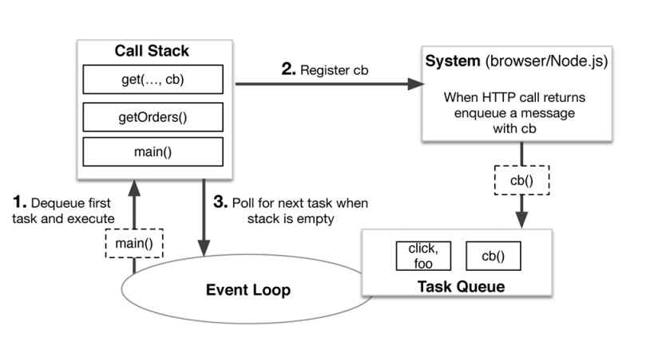
How Does JavaScript Work?
Image from article by Gallaba, Mesbah & Beschastnikh

Slide 17



Resources
What is the JavaScript event loop really all about - Java Brains

Slide 18
Summary
Basic Data Structures (Queue - Stack - Tree)
Arrow Function
Asynchronous programming
Event Queue

